Slide 2
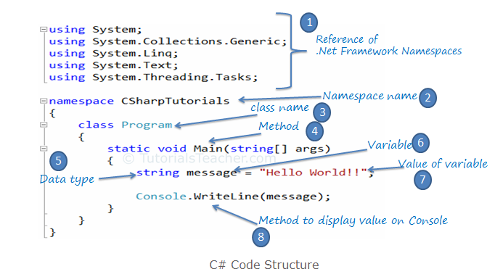
C#
C# is Object oriented programing language.
It developed by Microsoft and release 2002 latest version 7.3
C# can be use create various of application like Web , Windows, Console and other type using Visual Studio.

Slide 3
Data type
Data type as a Caste Which is define category
Int
Enum
Char
double
Float

Slide 4
What Is Name Space
Name SPACE is a collection of class,
its define two way
System.Console.WriteLine("Hello World!");
system is name space and console is class and 2. we know
. Operator is used to differentiate which method gets called.
What is Class
Group of object
Object is a real entity
What is Method
A method is a group of statements that together perform a task.
1. Define the method 2.Call the method

Slide 5
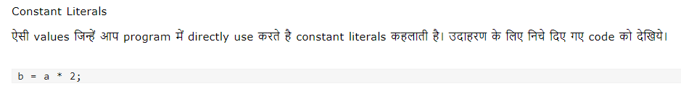
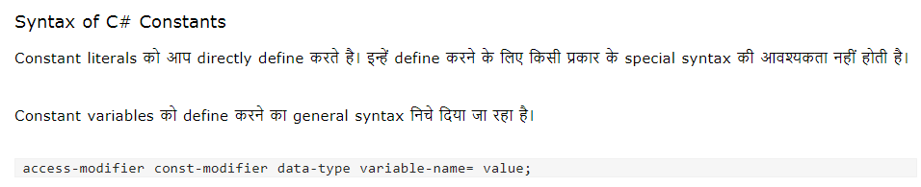
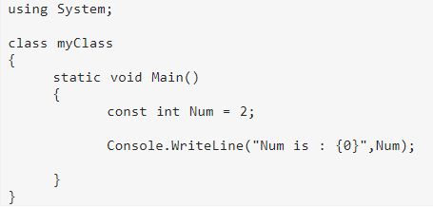
Constants

Slide 6
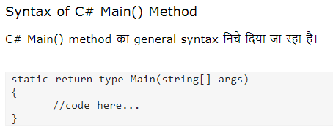
Main method()

Slide 7
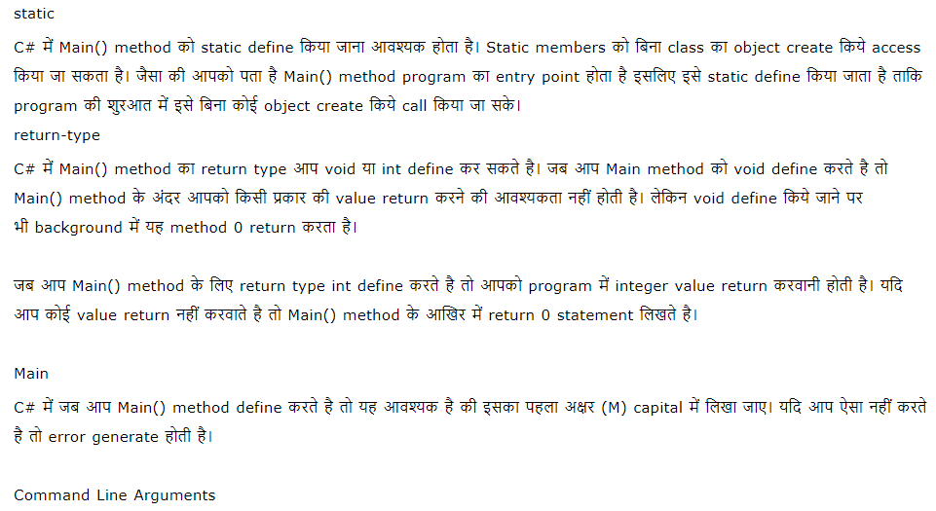

Slide 8
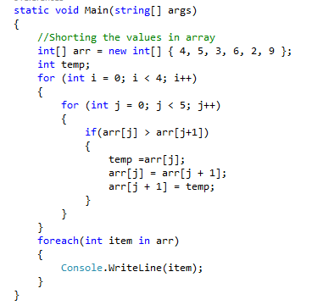
Array

Slide 9
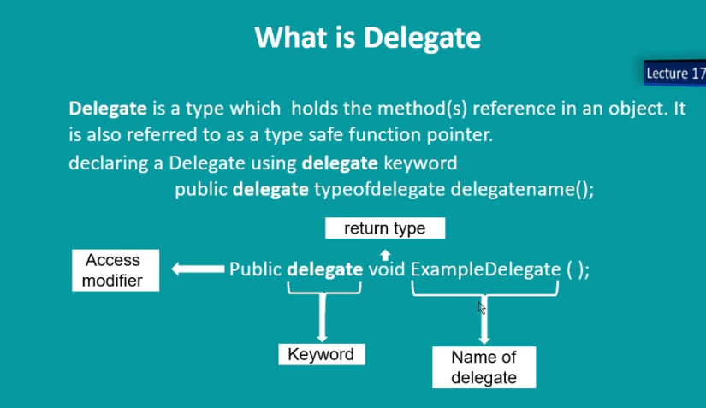
Delegates

Slide 10
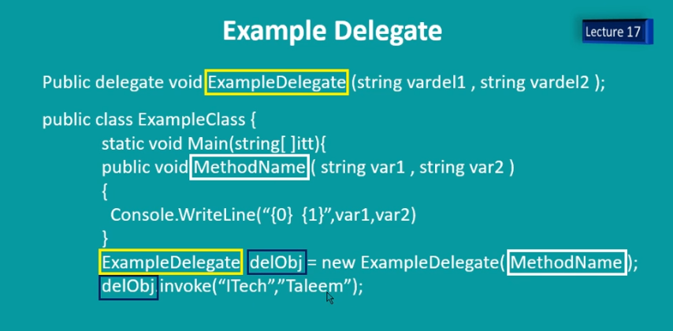

Slide 11
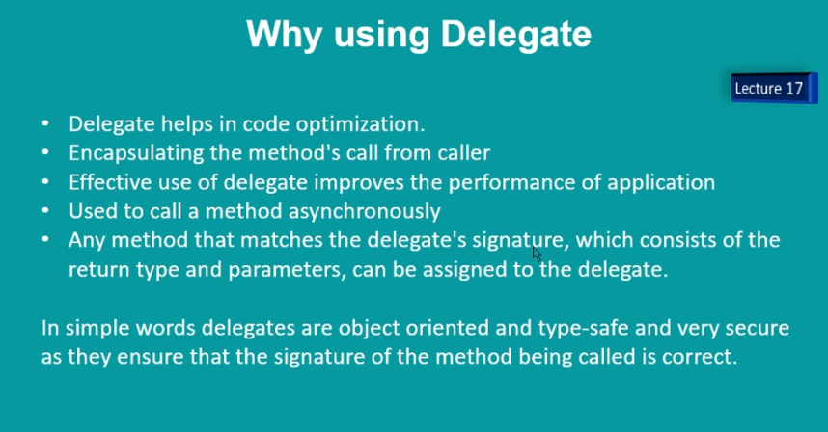

Slide 12
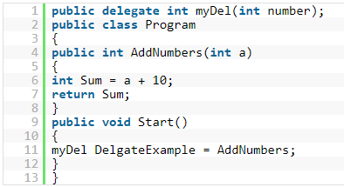

Slide 13
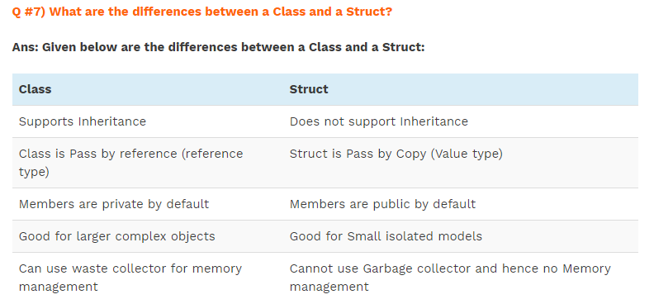

Slide 14
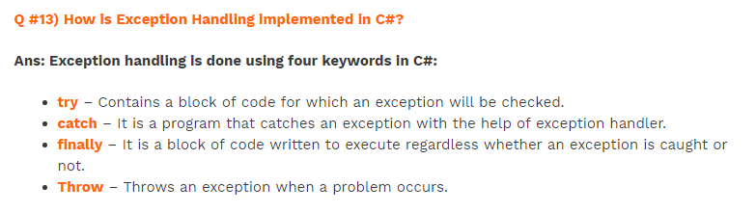

Slide 15
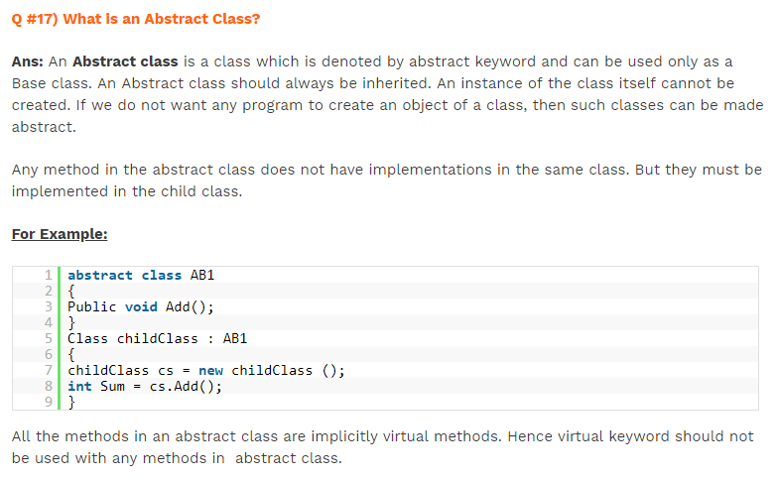

Slide 16
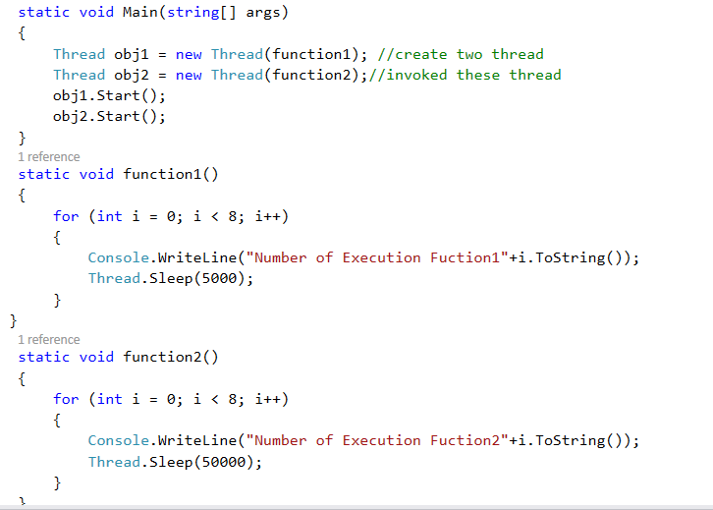
Thread and Multithreading
1. Thread is a execution of path of program
2. Thread is a lightweight process
3. Thread is parallel execution process
4. When we program execute the
different small thread execute
using System.Threading;

Slide 17
Interface
Interface just like a class but it can have a only signature of method it does not contain the implementation methods
By default interface (internal )

Slide 18
Abstract Class
Abstract class can not be create object
Abstract class use always base class

Slide 19
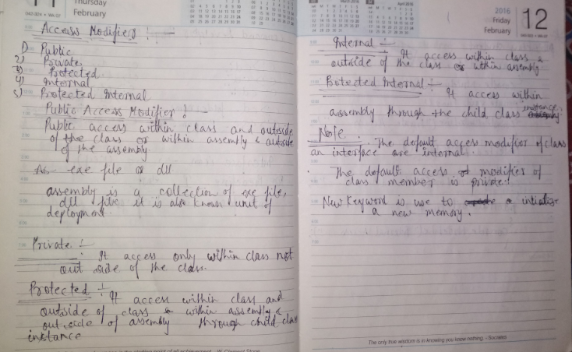

Slide 20
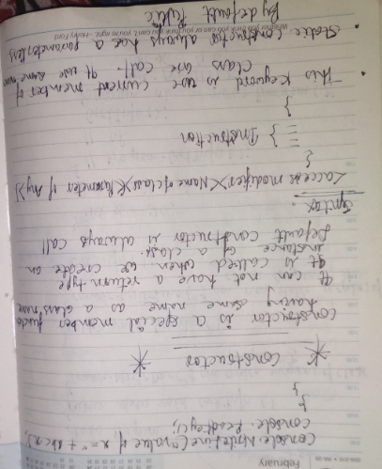
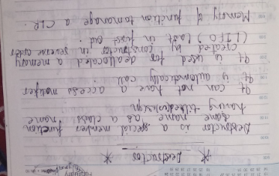

Slide 21
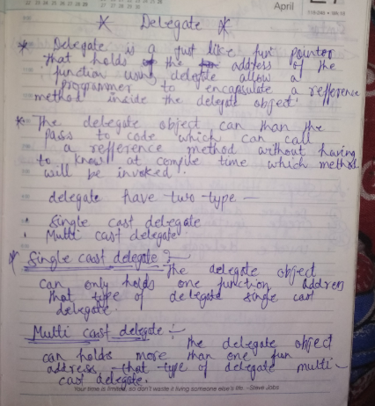
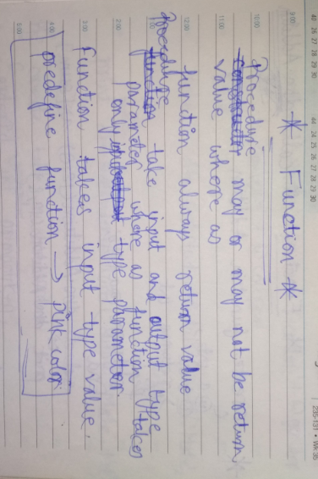

Slide 22
